Slide 1
MediBot: Online Disease Detection and Prediction Analysis

Slide 2
Agenda
Abstract
Introduction
Aim & Scope
Existing System
Proposed System
System Architecture
System Development
Testing
Conclusion
References

Slide 3
Abstract
Health is a vital topic for human lives.
Dataset is heart, breast and diabetes disease-related health care data. .
ML techniques, i.e., Naïve Bayes, K-means, SVM, ANN to compare their prediction accuracy.
A Chatbot will predict disease and recommend a specialized doctor for respective diseases

Slide 4
Objectives
Virtual Medical Assistant
Increase Accuracy
Patient Interaction
Analysis of Diseases using parameters.
Examine Diagnosis using ANN,RF and K-Means

Slide 5
Introduction
Human and Machines Interact each other .
Model predict the result with symptoms to get better accuracy.
Current Lifestyle with Diseases
We have utilized Machine Learning tools to predict type of diseases like clustering and prediction algorithms..
we are anticipating if the patient can have any Disease and the precision of the ailment.

Slide 6
Literature Survey
Medical Chatbot
Early Diagnosis of Human disease using AI
A Tool of Conversation:Automated Medical Chatbot
Chatbot Acceptance in Healthcare
Chatbot for Disease Prediction and Treatment using ML

Slide 7
DESIGN

Slide 8
Predictive Analysis
Descriptive Analysis on Diseases
Visual Exploration dataset
Create Scatter Charts
Perform Correlation analysis
Apply Classification algorithm to build model
Create Classification report

Slide 9
Diabetes Prediction

Slide 10
Heart Disease Prediction

Slide 11
Breast Cancer Prediction

Slide 12
Snapshots

Slide 13
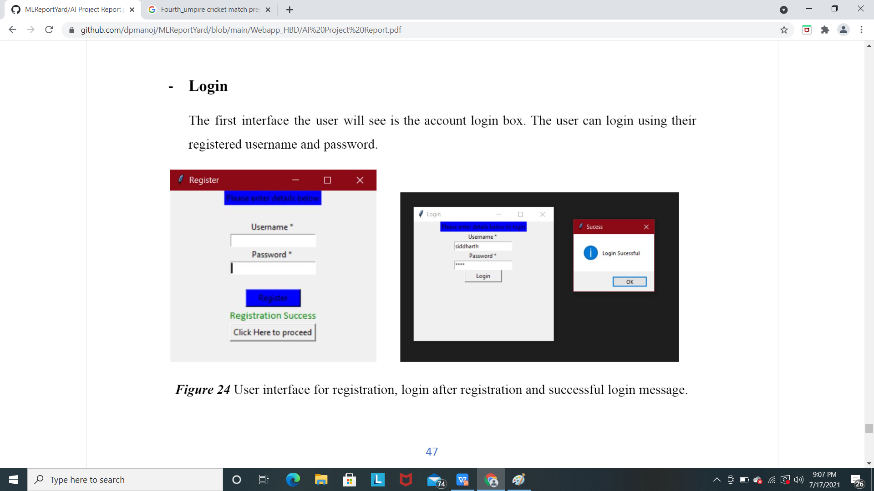
Snapshots

Slide 14
Snapshots

Slide 15
Snapshots

Slide 16
Snapshots

Slide 17
Snapshots

Slide 18
Snapshots

Slide 19
Snapshots

Slide 20
Conclusion
Provide User friendly and interactive environment for diagnosis of diseases.
Presents the Methodology for implementing a disease prediction system using symptoms.
Early and accurate Diagnosis of the disease with online doctor recommendation.
Helps providing best and on-time treatment to the patients.

Slide 21
References
Kalyan Nagaraj and Amulyashree Sridhar, “NeuroSVM: A Graphical User Interface
Kotsiantis. S.B, “Increasing the Classification Accuracy of Simple Bayesian
Esraa M Hashem, Mai S Mabrouk (2014). “A Study of Support Vector Machine Algorithm for Liver Disease Diagnosis”, American Journal of Intelligent Systems.
Anju Gulia, Dr. Rajan Vohra , Praveen Rani “Liver Patient Classification Using Intelligent Techniques”, International Journal of Computer Science and Information Technologies, Vol. 5 (4), 2014,

Slide 22
THANK YOU

